Slide 1
Constraint-Friendly Map-to-Elliptic-Curve-Group Relations (and Their Applications)
Harjasleen (Jasleen) Malvai
(UIUC, IC3)
joint work with Yinuo Zhang (UC Berkeley), Andrew Miller (Teleport, UIUC and IC3) and Jens Groth (Nexus)
Notes:
Hello everyone, I am Jasleen Malvai and I’m a PhD candidate at UIUC, today I will be presenting our work on constraint friendly map-to-elliptic curve group relations, which is joint work with Yinuo Zhang, Andrew Miller and Jens Groth.

Slide 2
Multiset Hash Functions
Message space M,
Digest space D
MultisetHash: S → d,
S⊂ M, d ∈ D
Properties:
  Collision resistance: S₁ ≠ S₂ ⇒ MultisetHash(S₁ ) ≠ MultisetHash(S₂).
  Compression: MultisetHash(S) is small, regardless of the size of S.
Notes:
To motivate map-to-curve relations, I’ll first introduce something called a multiset hash function,
The name is pretty self-explanatory, a multiset hash consists of a message space M,
A digest space D and it maps subsets of M to D.
What properties do you want, now?
Similar to usual hash function properties:
Collision resistance and compression.
Note that one additional property compared to regular hashes is that ordering does not matter.

Slide 3
Multiset Hash Functions
Message space M,
Digest space D
MultisetHash: S → d,
S⊂ M, d ∈ D
Classical construction: D is a (additive) group in which DLOG is hard,
Suppose HashToGroup: M → D is a function that hashes items in M to D.
MultisetHash(S) = ∑_{m ∈ S} HashToGroup(m).
Notes:
To motivate map-to-curve relations, I’ll first introduce something called a multiset hash function,
The name is pretty self-explanatory, a multiset hash consists of a message space M,
A digest space D and it maps subsets of M to D.
So a classical construction goes like this: D is a group which is DLOG hard,
You have HashToGroup which maps from the message space to the digest space and we assume it’s a random oracle.
The multiset hash is just the summation of the hashes of each message m to the group.
So you ask why is this a collision resistant multiset hash?

Slide 4
Multiset Hash Function: Classical Construction
Classical construction: D is a group in which DLOG is hard,
Suppose HashToGroup: M → D is a function that hashes items in M to D.
  Assume HashToGroup is a random oracle.
MultisetHash construction [BM’97]:
MultisetHash(S) = ∑_{m ∈ S} HashToGroup(m).
Collision resistance in ROM: Contradiction, suppose S ≠ T and
MultisetHash(S) = MultisetHash(T)
⇒ ∑_{m ∈ S} HashToGroup(m) - ∑_{n ∈ T} HashToGroup(n) = 0
Counting multiplicities, this means that the adversary found non-trivial a_{m}’s such that
∑_{m ∈ S U T} a_{m} HashToGroup(m) = 0,
If HashToGroup is a random oracle, then this breaks DLOG.
Notes:
A classical construction goes like this: D is a group which is DLOG hard,
You have HashToGroup which maps from the message space to the digest space and we assume it’s a random oracle.
The multiset hash is just the summation of the hashes of each message m to the group.
So you ask why is this a collision resistant multiset hash?
So to argue the collision resistance in the random oracle model, the argument goes like this:
Suppose you have two multisets S_1 and S_2 which are unequal.
But their multiset hashes are equal.
This means that the summations of the hashes of the items in the two sets are equal.
This means the adversary must have found some multiplicities such that the sum is 0.
Now, if hashtogroup is a random oracle, this would break dlog.
BTW this is an older result, it first appeared in 1997 in the work of Bellare and Micciancio

Slide 5
Multiset Hash Functions
Classical construction:
MultisetHash(S) = ∑_{m ∈ S} HashToGroup(m).
Collision resistant by: random oracle property of HashToGroup + DLOG.
Other properties:
  Compression: MultisetHash(S) is small, regardless of the size of S.
  Incrementality: MultisetHash(S U T) is efficient to compute:
MultisetHash(S) + MultisetHash(T).
Corollary: MultisetHash(S U { e }) = MultisetHash(S) + HashToGroup(e).
Notes:
So this construction is not only collision resistant, but also has a few other nice properties,
The first is compression, since the multiset hash is small, regardless of the size of S – just one group element.
The second is incrementality, so if you have the multiset hash of two sets, you can efficiently compute the hash of their union by just adding the individual hashes.
This also has a nice corollary, which is you can just use one hash and an addition to add on one more item.
Initially this was mostly used to build hash functions.
This last property is useful for applications like recursive SNARKs!

Slide 6
Programming Model for Proof Systems: Constraint Programming
A predicate of the form y = f(x), can be represented as a set of “constraints”.
Instead of computing all variables, as in regular programming, can provide “witnesses”.
Examples:
  Boolean circuits,
  Arithmetic circuits,
  Rank-1 constraint satisfaction (R1CS), etc.
  Result is valid if there exists a witness assignment satisfying constraints.
Used in zkVMs (e.g. Jolt, SP1, Risc-0, Nexus).
Notes:
Since I mentioned proof systems, I’ll take a quick aside and mention that the programming model for proof systems is different from regular programming.
A way to represent RAM can also be done through constraints

Slide 7
Constraint system motivation: zkVM Memory Consistency
Operation | Time | Read | Write
Initialize | 1 |  | (addr₁ , v₁, 1)
Initialize | 2 |  | (addr₂ , v₂, 2)
Load addr₂ | 3 | (addr₂ , v₂, 2) | (addr₂ , v₂, 3)
Store addr₁ , v₁’ | 4 | (addr₁ , v₁, 1) | (addr₁ , v₁’, 4)
Load addr₁ | 5 | (addr₁ , v₁’, 4) | (addr₁ , v₁’, 5)
Finalize | 6 | (addr₁ , v₁’, 5)
Finalize | 7 | (addr₂ , v₂, 3)
Notes:
One big recent motivation is memory consistency in proof systems.
So what functionality are we looking for? We’re basically looking for a RAM solution.
What you do here is you initialize the memory, for illustration we’ll only have a tiny memory with 2 addresses, and after that you do some memory operations.
Each time I do a read, I’ll write it back and each time I do a write, I’ll read beforehand. This ends up being necessary for building a solution you can prove efficiently using multiset hashing, but also, you could think of this as “hiding” or being oblivious in the operation you’re doing.
At the end we do one final “read” of each location, to correct the asymmetry from the initialization step.
Now notice that the read set and the write set are equal as multisets. ← This is our final constraint regarding the RAM.

Slide 8
zkVM Memory Consistency via Multiset Hashes
Operation | Time | Read | Write | d_{RS} | d_{WS}
Initialize | 1 |  | (addr₁ , v₁, 1) | 0 | H(addr₁ , v₁, 1)
Initialize | 2 |  | (addr₂ , v₂, 2) | 0 | d_{WS}+H(addr₂ , v₂, 2)
Load addr₂ | 3 | (addr₂ , v₂, 2) | (addr₂ , v₂, 3) | d_{RS}+H(addr₂ , v₂, 2) | d_{WS}+H(addr₂ , v₂, 3)
Store addr₁ , v₁’ | 4 | (addr₁ , v₁, 1) | (addr₁ , v₁’, 4) | d_{RS}+H(addr₁ , v₁, 1) | d_{WS}+H(addr₁ , v₁’, 4)
Load addr₁ | 5 | (addr₁ , v₁’, 4) | (addr₁ , v₁’, 5) | d_{RS}+H(addr₁ , v₁’, 4) | d_{WS}+H(addr₁ , v₁’, 5)
Finalize | 6 | (addr₁ , v₁’, 5) |  | d_{RS}+H(addr₁ , v₁’, 5) | d_{WS}
Finalize | 7 | (addr₂ , v₂, 3) |  | d_{RS}+H(addr₂ , v₂, 3) | d_{WS}
Theorem [SAGL’18]: Reads and writes are consistent ⇔ d_{RS} = d_{WS}
Notes:
So we can use our incremental multiset hash at each read and write to show multiset equality!

Slide 9
zkVM Memory Consistency via Multiset Hashes
Operation | Time | Read | Write | d_{RS} | d_{WS}
Initialize | 1 |  | (addr₁ , v₁, 1) | 0 | H(addr₁ , v₁, 1)
Initialize | 2 |  | (addr₂ , v₂, 2) | 0 | d_{WS}+H(addr₂ , v₂, 2)
Load addr₂ | 3 | (addr₂ , v₂, 2) | (addr₂ , v₂, 3) | d_{RS}+H(addr₂ , v₂, 2) | d_{WS}+H(addr₂ , v₂, 3)
Store addr₁ , v₁’ | 4 | (addr₁ , v₁, 1) | (addr₁ , v₁’, 4) | d_{RS}+H(addr₁ , v₁, 1) | d_{WS}+H(addr₁ , v₁’, 4)
Load addr₁ | 5 | (addr₁ , v₁’, 4) | (addr₁ , v₁’, 5) | d_{RS}+H(addr₁ , v₁’, 4) | d_{WS}+H(addr₁ , v₁’, 5)
Finalize | 6 | (addr₁ , v₁’, 5) |  | d_{RS}+H(addr₁ , v₁’, 5) | d_{WS}
Finalize | 7 | (addr₂ , v₂, 3) |  | d_{RS}+H(addr₂ , v₂, 3) | d_{WS}
Note 1: The multiset hash needs to be computed inside the proof system’s constraint system!
Corollary: If the multiset hash is not constraint-friendly, the zkVM will be slow!
Notes:
Note 1: The multiset hash needs to be computed inside the proof system’s constraint system!
Corollary: If the multiset hash is not constraint-friendly, the zkVM will be slow!

Slide 10
From Hash-to-Group to Map-to-Group Relations
Notes:
Remember MultisetHash uses a sum of HashToGroup outputs, so let's zoom in on that.

Slide 11
Hash-to-Group Example Construction
Parameters: Group G is an elliptic curve group E(F_{q}): y² = x³ + ax + b with p points,
Message space M⊆F_{q}​,
hash: M → F_{q}​ is a cryptographic hash function,
F: F_{q}​ → G
Procedure: Increment and check, to map m to curve
Let m’ = hash(m), (x, y) = F(m’),
t = 0
While (x, y) = ⊥,
  m’ = hash(m + t), (x, y) = F(m’)
  t = t + 1
Return (x, y)

Slide 12
Hash-to-Group Example Construction
Parameters: Group G is an elliptic curve group E(F_{q}): y² = x³ + ax + b with p points
Message space M ⊆ F_{q}​
hash: M → F_{q}​ is a cryptographic hash function
MapToGroup: F_{q}​ → G
Classical construction
Procedure: Let h = hash(m), (x, y) = MapToGroup(h).
HashToGroup is just a hash function + MapToGroup
Constraints/SNARK/Proof system:
Input/witness: m, x, y
Verification: h = hash(m), (x, y) = MapToGroup(h)
Issue: You have to compute hash(m) as part of the proof.
Notes:
Remember MultisetHash uses a sum of HashToGroup outputs, so let's zoom in on that.
Zooming in a little more, let’s look at the hash-to-group primitive we now need to encode in a snark.
The parameters are
The elliptic curve group, with a base field
The message space, which we now assume is in the field as well, because that’s the case for SNARKs,
Then you have a cryptographic hash function that maps messages to the field,
And finally you have a function MapToGroup that goes from the base field to the group.
Procedure: So you can use the hash function to sort of randomize the message, then you just use the function to map it to the group.
In the proof system: You now just give the message and the curve group element’s coordinates as input or witness and verify the hash and the correct output of the function F.
Issue: Now you have to show correct hash function computation in the constraint system.

Slide 13
Why Hash-to-Group is a Problem in Circuits
Hash functions have high circuit constraint cost!
Hash Function | Constraints: 1 iter. | Constraints: 2¹⁰ iters.
SHA-256 | 7,095 | 4,196,023
Poseidon | 948 | 954,384
MiMC | 351 | 343,056
CHALLENGE:
Can we remove the use of cryptographic hash, while still building a multiset hash function?
Notes:
Why is this an issue, you ask?
Well, hash functions have really high constraint cost, here’s some constraints in PLONK!
So our challenge is to remove this hashing requirement and still building a multiset hash function by mapping to a group somehow.

Slide 14

Why do we need the hash function? (Part I)
In an elliptic curve group of order p, each group element can be identified by its unique discrete log in F_{p}.
To ensure collision-resistance of the multiset hash, the only thing we need is a random oracle from message space M to the discrete logs in F_{p}.
Random Oracle
Discrete logs $F_{p}$
Message M
Notes:
So in an elliptic curve of order p, each item has a unique discrete log and,
To build the multiset hash, we want to make sure to map to these unique DLOGs in a randomized way

Slide 15



Why do we need the hash function? (Part II)
In the classical hash-to-group construction: the hash function is a random oracle from message space M to $F_{q}$.
This is followed by an injective map-to-elliptic-curve group function.
Composing a random oracle with an injective function is still a random oracle.
Message Space
M
Base Field
$$F_{q}$$
Discrete logs $F_{p}$
Map-to-G
Hash
Random oracle
Injective Function
Random Oracle
Notes:
Classical hash-to-group: the hash function gives a random oracle from message space to the base field.
Now, map-to-group is injective and induces an injective encoding from field to group.
Together, with the random oracle, this is all still a random oracle.

Slide 16
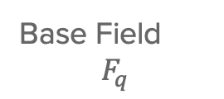

The Generic Group Model
To drop the hash function, we must identify another source of random oracle!
We achieve this by relying on the Elliptic Curve Generic Group Model (EC-GGM).
In this model, the Map-to-elliptic curve group function can be almost seen as a random oracle!
Discrete logs $F_{p}$
Base Field
$$F_{q}$$
Map-to-G
Almost Random Oracle in EC-GGM
Notes:
So what happens if we don’t use a random oracle?
The discrete logs are hidden in the EC-GGM so it’s basically a random oracle mapping between basefield items and discrete logs.

Slide 17

Map-to-Group is ALL YOU NEED
Let’s zoom back to the classical hash-to-group function.
In the EC-GGM, we have two random oracles now.
Message
Space
M
Base Field
$$F_{q}$$
Hash
Map-to-G
Discrete logs F_{p}
Random oracle
Almost Random oracle
(EC-GGM)
Notes:
Let’s zoom back to the classical hash-to-group function.
In the EC-GGM, we have two random oracles now.
Wait… “Map-to-Group is ALL YOU NEED.”

Slide 18

Map-to-Group is ALL YOU NEED
Let’s zoom back to the classical hash-to-group function.
In the EC-GGM, we have two random oracles now.
Wait… “Map-to-Group is ALL YOU NEED.”
Message
Space
M
Message Space
$$M⊆F_{q}$$
Hash
Map-to-G
Discrete logs F_{p}
Random oracle
Almost Random oracle
(EC-GGM)
Notes:
But recall we said the message is in the basefield!
So map-to-group is all you need.
And obvously you add them up for multiset hash.

Slide 19
Map-to-Group Function [BLS’01]
Parameters: Group G is an elliptic curve group E(F_{q}): y² = x³ + ax + b with p points,
Message space M = {0, 1, …, 2^{k} - 1} e.g. in a zk-vm k = 96, so we get 3 32 byte words
Tweak space T = {0, 1, …, 2^{u} - 1} e.g. u = 8 (1 byte tweak).
Procedure: to compute MapToGroup(m):
t = 0,
x = t + m |T| and y is computed using the curve eq.
While (x, y) is not a valid curve pt:
  t = t + 1
  x = t + m |T|, y is computed using the curve eq.
Return (x, y).
Issues:
1. This map-to-group function is non-deterministic.
2. The “while loop” uses many constraints.
Notes:
With this insight, let’s try to consider one idea for the function f that will be useful for the SNARK application. It’s a variant of the idea from BLS which uses a hash function.
Parameters: Group G is an elliptic curve group E(F_{q}): y² = x³ + ax + b with p points,
Message space M = {0, 1, …, 2^{k} - 1} e.g. in a zk-vm k = 96, so we get 3 32 byte words
Tweak space T = {0, 1, …, 2^{u} - 1} e.g. u = 8 (1 byte tweak).
f: F_{q}​ → G is injective and inverse excluding,
Procedure: to compute f(m):
t = 0, x = t + m |T|, y is computed using the curve eq.
While sqrt( y ) is invalid,
t = t + 1
x = t + m |T|, y is computed using the curve eq.
Return (x, y).
Issue: You have to prove t is the smallest possible tweak as part of the proof. Of course, in SNARK programming this becomes untenable.

Slide 20
Map-to-Group Languages and Relations
Idea: In constraint programming, we can allow for nondeterministism.
Instead of viewing Map-to-Group as a function, we view it as a relation!
Relation R_{M2G}(m, P, w) with:
  Point constraint: P∈ G.
  x-constraint: ensures injectivity wrt m.
Notes:
So we get rid of this overhead by using a relation, instead of a function,
allow nondeterministic map-to-group outputs in the circuit:
A map-to-group language L: pairs (m, P) that are allowed.
Relation R_{M2G}(m, P, w) with:
Point constraint: P∈G.
x-constraint: ensures injectivity wrt x.

Slide 21
Map-to-Group Languages and Relations
Idea: allow nondeterministic map-to-group outputs in the circuit:
A map-to-group language L: pairs (m, P) that are allowed.
Relation R_{M2G}(m, P, w) with:
  Point constraint: P∈ G.
  x-constraint: ensures injectivity wrt m.
In the circuit:
Prover picks witness w = t “for free” (nondeterministically) and inputs (m, (x, y)), w:
Verifier just checks
  x = t + m |T|,
  y² = x³ + ax + b, // Group law
We’ve traded a heavy hash-to-curve function for a light relation 🙂

Slide 22
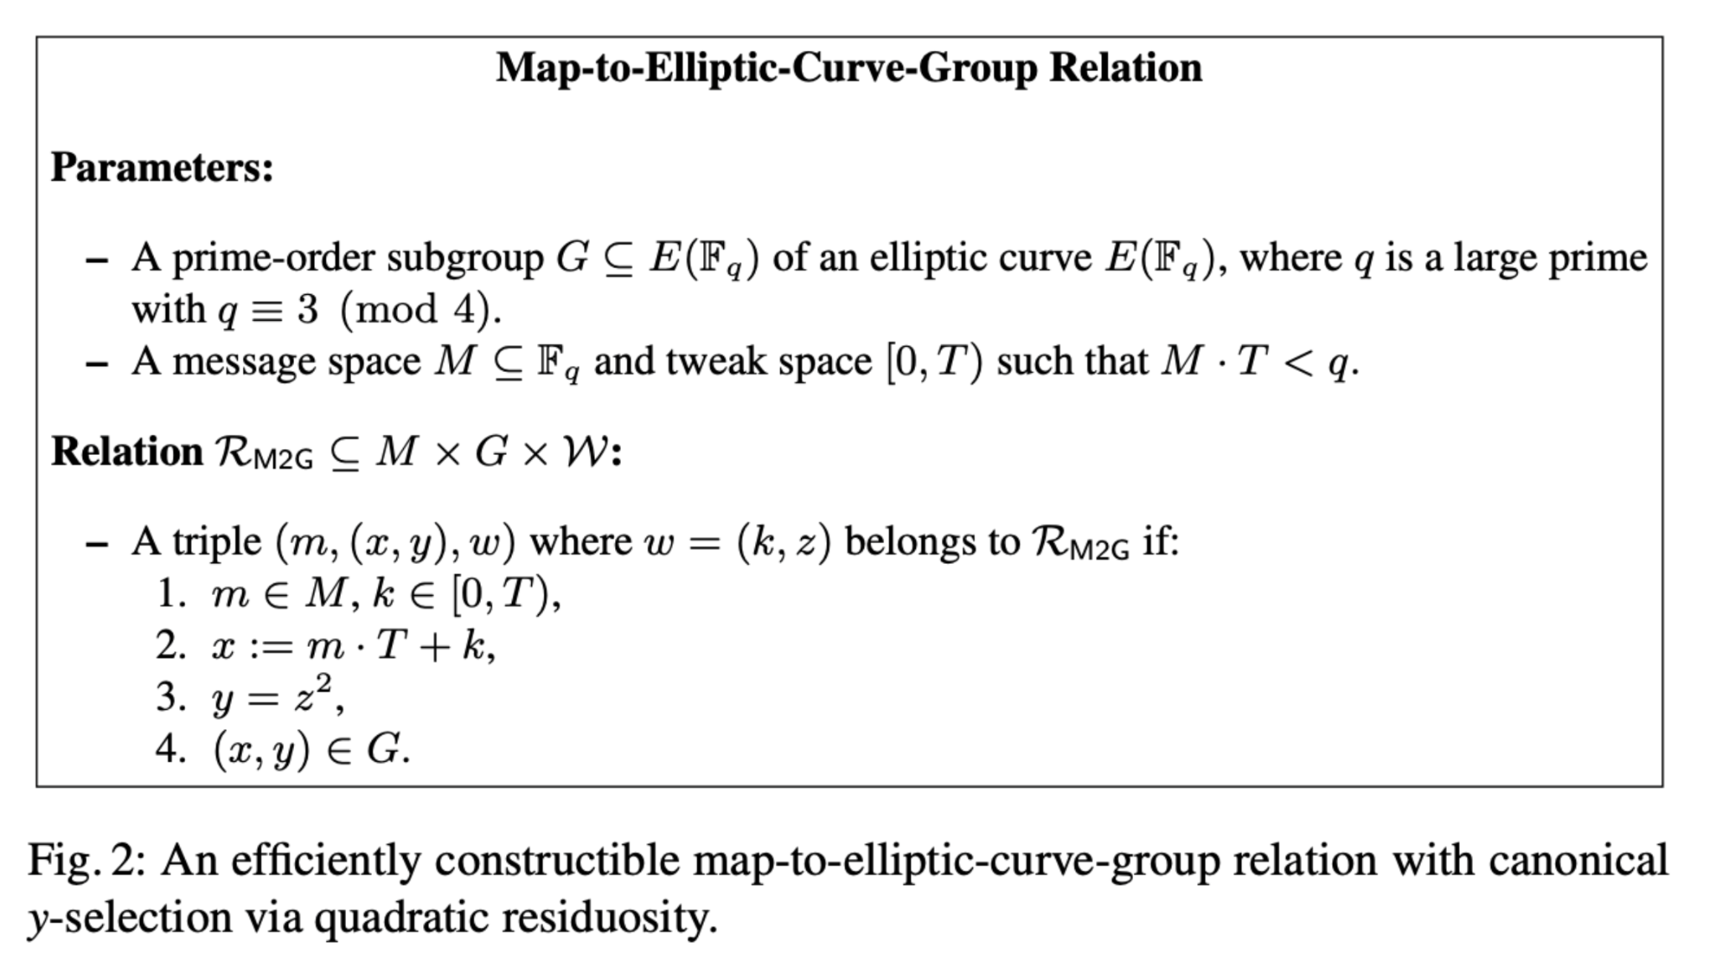
Map-to-Elliptic Curve

Slide 23
Map-to-group is efficient: #1
PLONK constraints from Noir over Grumpkin (a 254-bit prime field)
Instantiation | Constraints: 1 iter. | Constraints: 2¹⁰ iters.
SHA-256 hash-to-group | 7,095 | 4,196,023
Poseidon hash-to-group | 948 | 954,384
MiMC hash-to-group | 351 | 343,056
Map-to-group relation | 30 | 14,352
Notes:
We used a high level constraint programming framework called Noir to generate PLONK constraints.
Oh also, on the way over I coded this up in Arkworks, and it only took 15 R1CS constraints in that system probably due to variation in how the constants are instantiated etc.

Slide 24
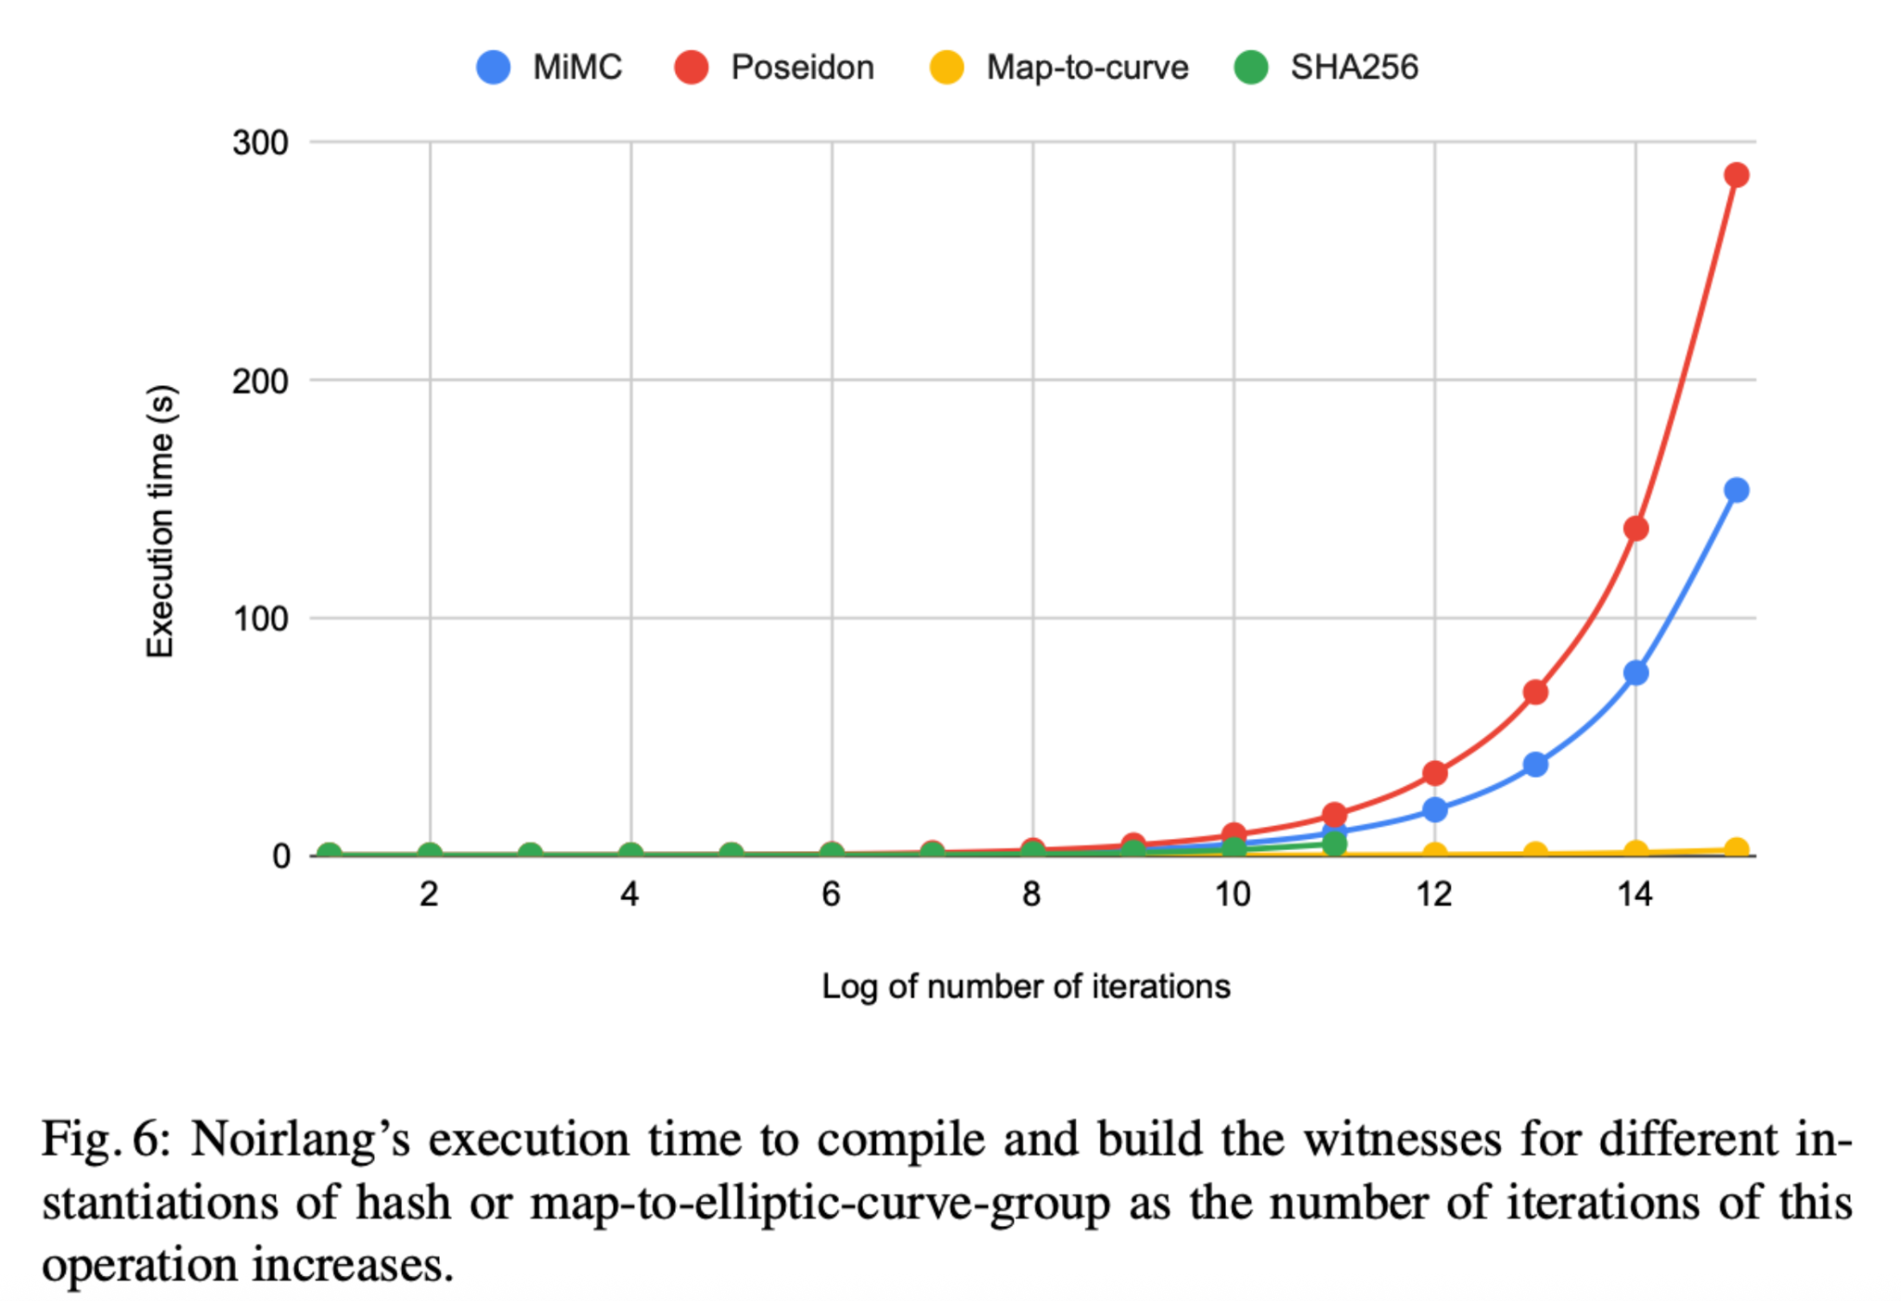
Map-to-group is efficient: #2
Notes:
Here’s the compilation and execution time in Noirlang
First of all notice that while Sha256 itself, which is down here is very efficient to compute in regular processors, so witness generation is fast, it's high constraint cost means it cannot even be compiled at 2^12 iterations -- Noir version we used only compiles circuits of up to 2^23 constraints.
If you're wondering where Map-to-curve sits, it's way down here by the x axis.

Slide 25
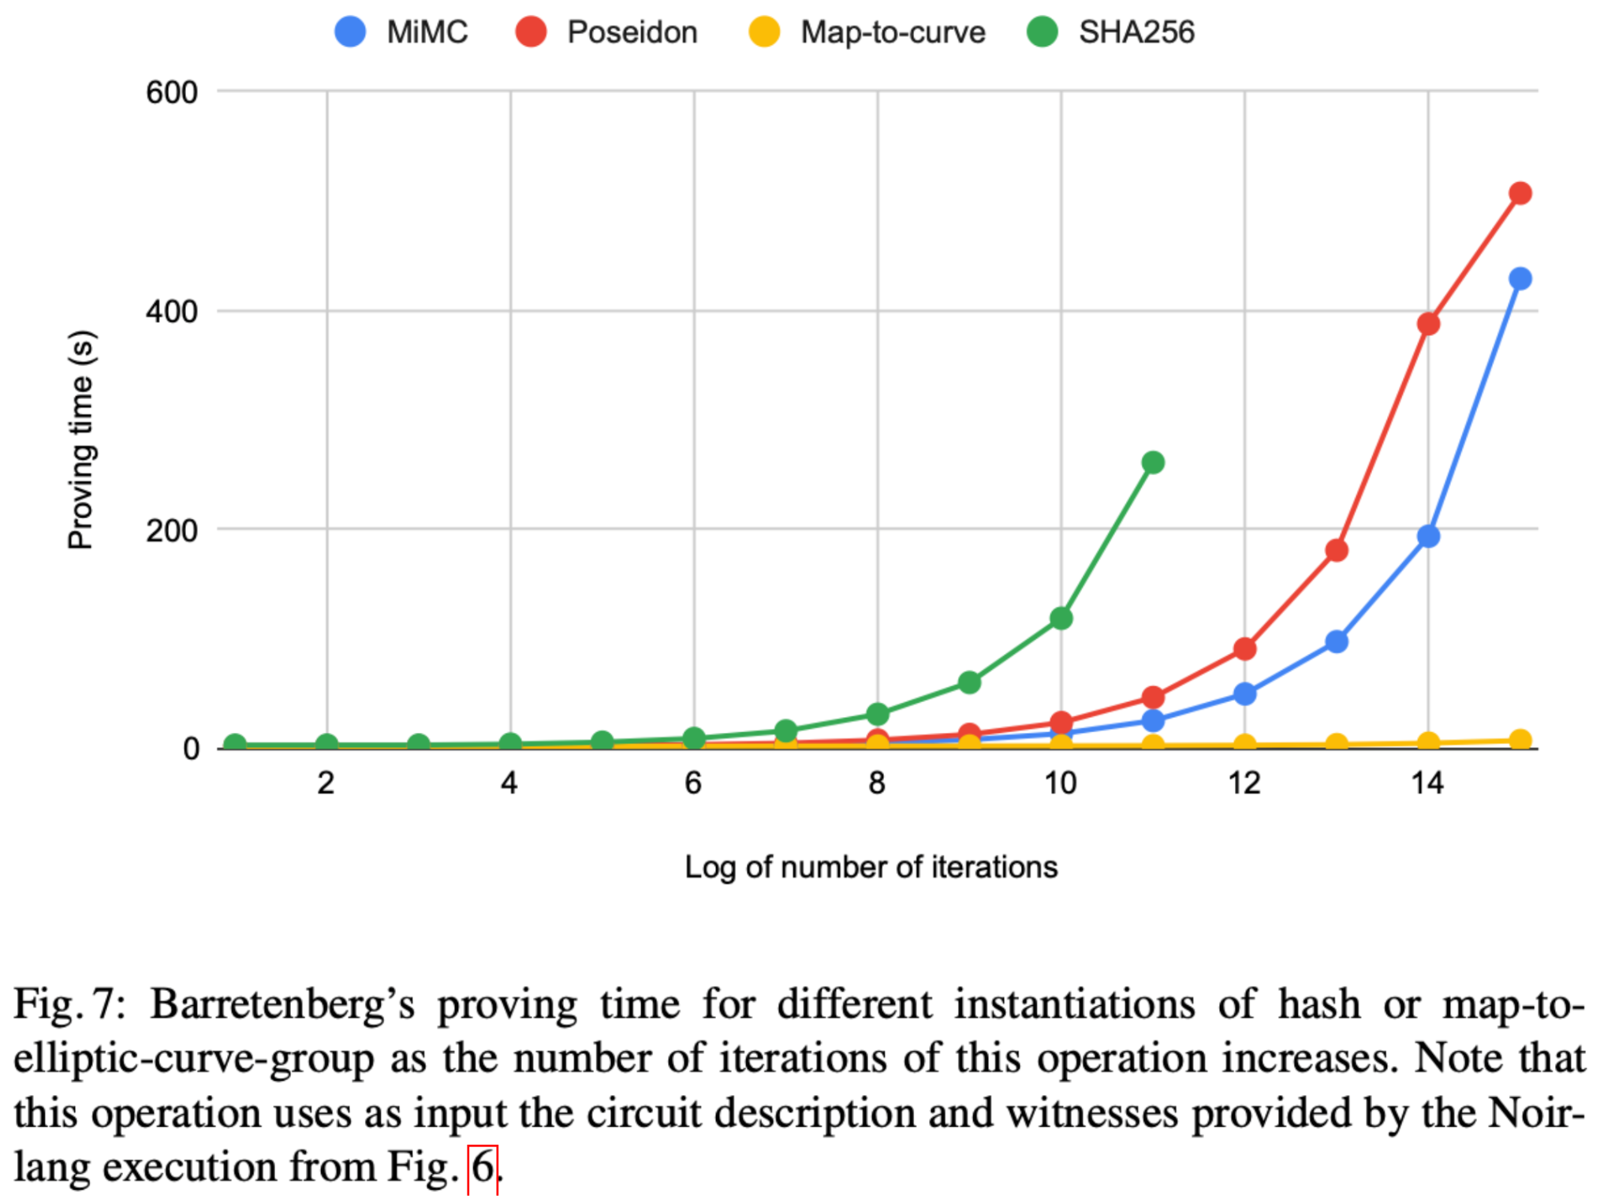
Map-to-group is efficient: #3
Notes:
And here’s the proving time using the plonk prover implementation that comes with Noir.

Slide 26
Thank you!

Slide 27

PS I’m on the tenure-track faculty job market!
My website: jasleenmalvai.com

Slide 28
Security & Multiset Hashing in zkVMs

Slide 29
EC Generic Group Model for Elliptic Curves

Slide 30
Constraint-Friendly Multiset Hashing for zkVM Memory

Slide 31
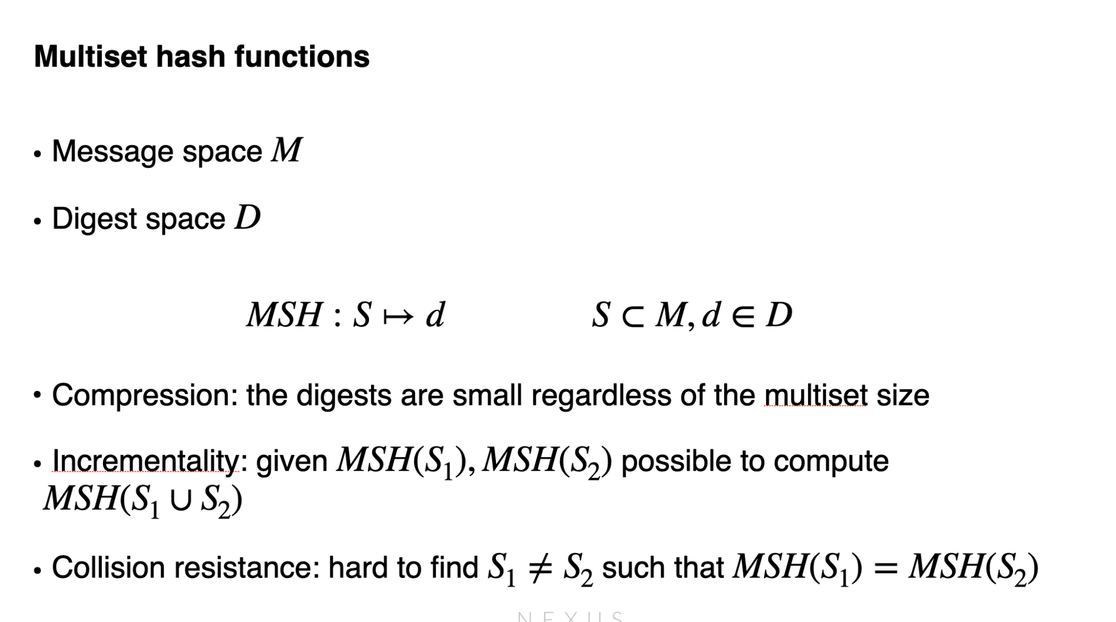
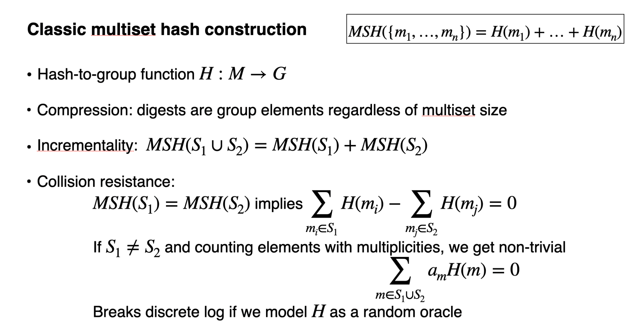
Read/Write Set: Drawback
Existing solutions consist of a primitive called “Multiset Hashing”.

Slide 32
Minimal Requirements & New Dangers
First, the good news:
If we have an injective map-to-group f:M→G, then
MSH(S)=∑m∈Sf(m)
still gives compression & incrementality.
In EC-GGM, collision-finding reduces to breaking a linear relation in random group elements.
Then the “danger”:
If f is not inverse-excluding (e.g. it maps both mm and m′m′ to PP and −P−P), a low-weight relation can give trivial collisions.
Define on-slide:
Injective and inverse-excluding (no message maps to both PP and −P−P).

